Slide 1

Fluids Review
Head loss, shear, vena contracta, and other concepts that enable a “smart fluids” design

Slide 2
Motivation
We will use smart physics and fluids to create elegant designs
Computer controlled flows and water levels in water treatment plants are
Easier to design and MUCH harder to maintain
Unnecessary complexity that gets in the way of successful plant operation (unless remote operation is required)
Prone to failures (not a resilient design approach)

Slide 3
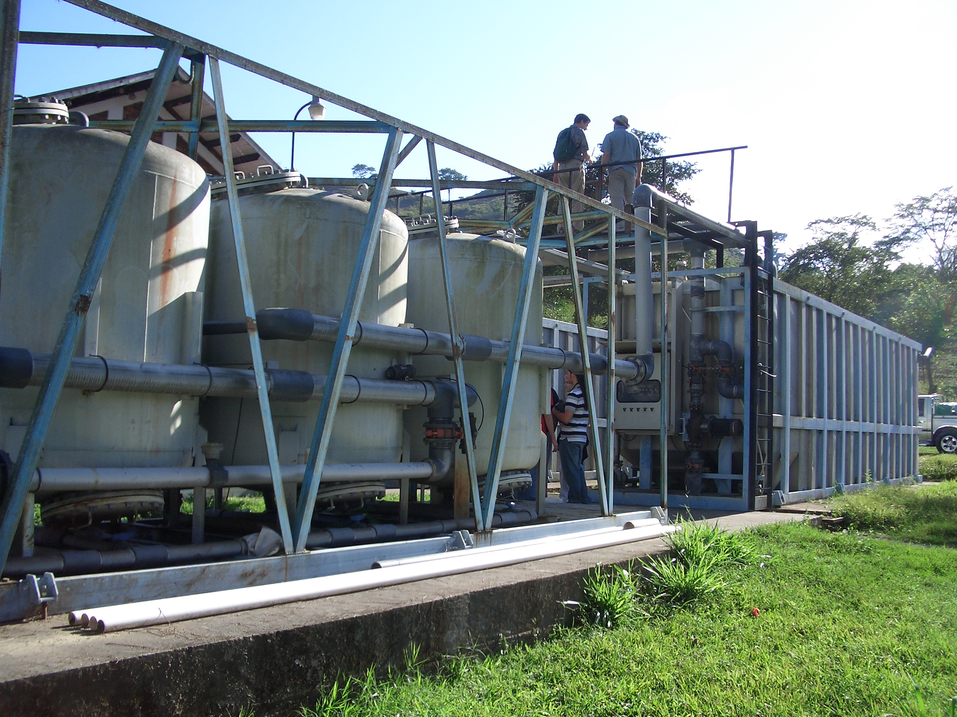
Dominant Design Constraint?
Notes:
What was the constraint used to create this design???? Constraints matter! The design you create will strongly reflect the constraints that you used to guide the design.

Slide 4
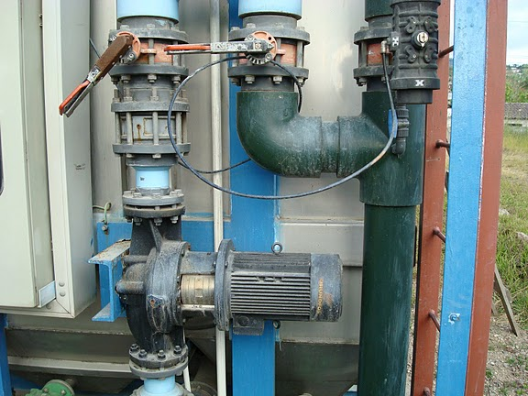

Slide 5
Fluids Review
Drag (flow around objects)
Head loss (flow in pipes and channels)
Bernoulli and Energy Equation

Slide 6

What causes the majority of air drag on a bicycle (including the rider)?
Pressure drag (normal force)
Shear drag (tangent force)
Lift drag

Slide 7
drag
Which orientation causes more drag?
Round disk tangent to wind
Round disk perpendicular to wind
Hemisphere with convex side facing wind
Hemisphere with concave side facing wind

Slide 8
Streamlines
Draw the streamlines that begin on the upstream side of the object for these two cases
Which object has the larger wake?
Which object has the lower pressure in the wake? (if streamlines are bending hard at the point of separation, then the streamlines will be close together…)

Slide 9
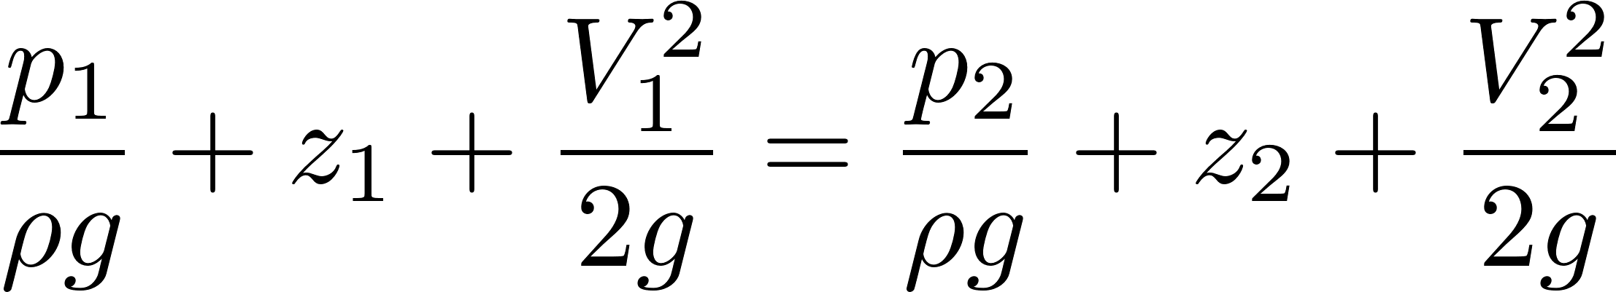
Why is there drag?
Fluid separates from solid body and forms a recirculation zone
Pressure in the recirculation zone must be low because velocity in the adjacent flowing fluid at the point of separation is high
Pressure in recirculation zone (the wake) is relatively constant because velocities in recirculation zone are low
Pressure behind object is low - DRAG

Slide 10
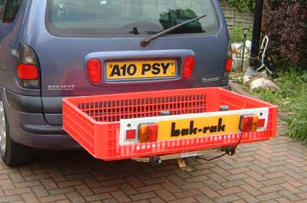
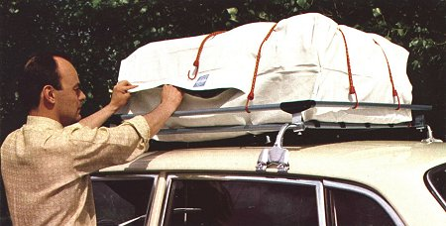
luggagebehindortop
I’m going on vacation and I can’t pack all of our luggage in my car. Where should I put it to reduce the drag on the car?
on the roof rack on top of the car.
on the hitch behind the car.

Slide 11
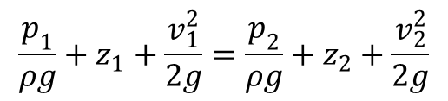
BernoulliOrEnergy
Which equation do you use to measure the head loss in a pipe system?
Control Volume Energy equation
Bernoulli equation
These are the same equations
$$\frac{p_{1}}{ρg}+z_{1}+\frac{v_{1}^{2}}{2g}=\frac{p_{2}}{ρg}+z_{2}+\frac{v_{2}^{2}}{2g}$$

Slide 12
Which conversion loses mechanical energy to heat?
Potential energy (pressure or elevation) converted to kinetic energy in an abrupt flow contraction
Kinetic energy converted to potential energy in an abrupt flow expansion
Note: This is the same as asking, “Where can you apply the Bernoulli equation?”
Notes:
Acceleration is efficient!!!!
Deceleration is inefficient!
Where can you apply Bernoulli?

Slide 13
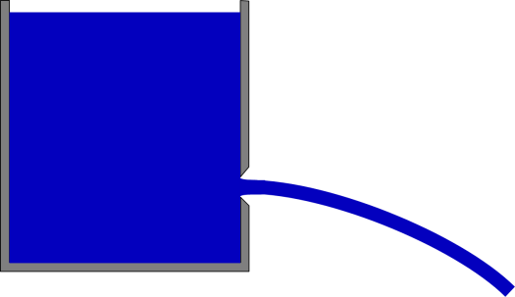
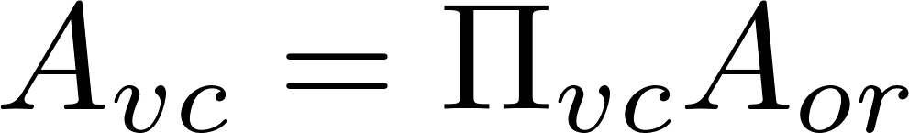
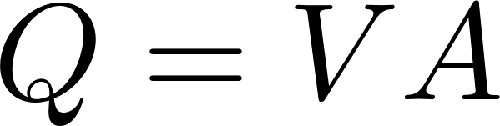

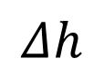
Orifice Equation
z₁
$$Δh$$
z₂ = 0
Flow contraction!
mechanical
Bernoulli equation (no energy loss)
^
Area of the constricted flow
Continuity equation
Orifice Equation (memorize this!)

Slide 14
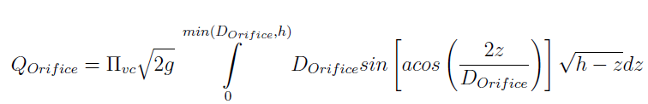
Orifice Equation
z₁
$$Δh$$
z₂ = 0
Flow contraction!
This equation applies to a horizontal orifice (so that the depth of submergence is constant throughout the entire orifice area). For depth of submergence larger than the diameter of the orifice this equation can be applied to vertical orifices. The USGS published a great solution for flow through partially submerged vertically oriented orifices

Slide 15
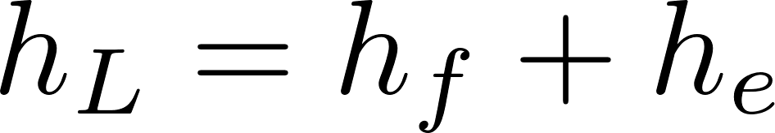
Two kinds of drag Two kinds of head loss
Drag (external flows)
Head loss (internal flows)
Skin (or shear) friction
Shear on solid surface
Classic example is flat plate
Form (or pressure) drag
Separation of streamlines from solid surface and wake results in a…
Flow expansion (behind object)
Major losses (h_{f} – friction)
Shear on solid surface
Shear on pipe walls
Minor losses (h_{e} – expansion)
Separation of streamlines from solid surface results in a…
Flow expansion
Energy equation (NOT THE BERNOULLI EQUATION)

Slide 16
A long streamlined train and a long straight pipeline are similar in that
They both have significant energy losses due to shear between fluid and the solid surface
They both have significant energy losses due to flow expansions

Slide 17
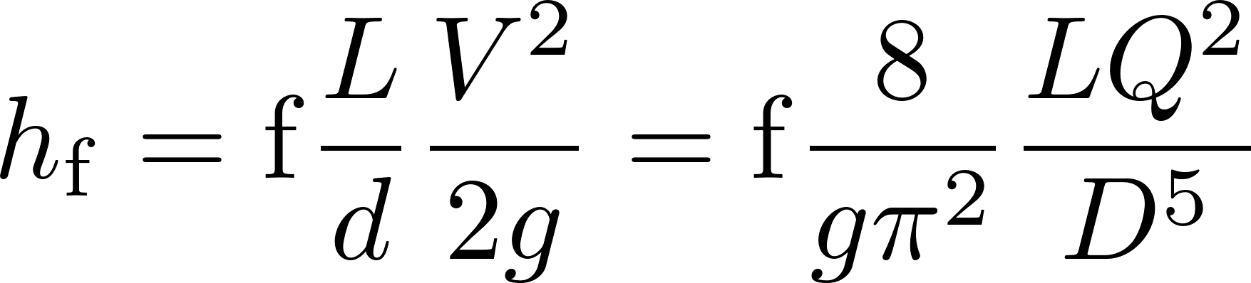
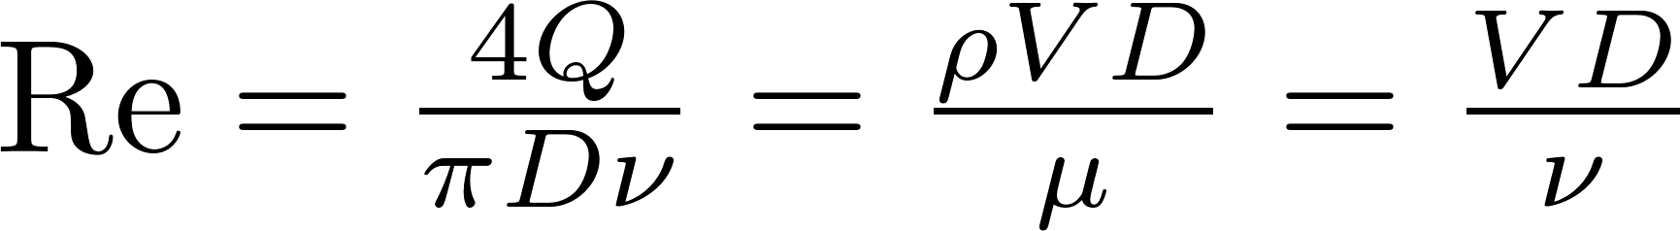
Head Loss in a Long STRAIGHT Tube (due to wall shear): Major Losses
Darcy Weisbach:
This equation gives the major losses for BOTH laminar and turbulent flow.
How to find the friction factor for wall shear, f?
First, find Reynold’s number
Transition from turbulent to laminar occurs at Re~2100

Slide 18
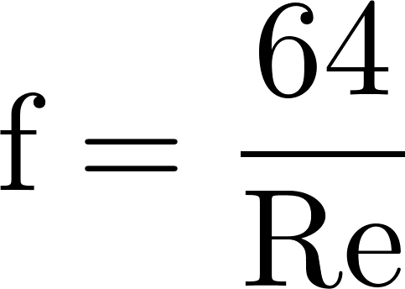
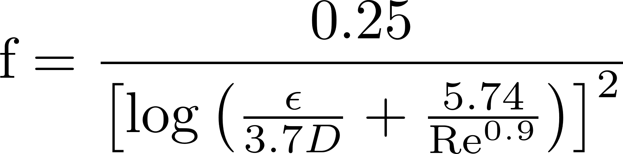

Head Loss in a Long STRAIGHT Tube (due to wall shear): Major Losses
Laminar
if Re < 2100,
Turbulent
if Re > 2100,
Swamee-Jain:
Major loss equation simplification
(for laminar flow only!):
Where Ɛ is the wall roughness
Hagen-Poiseuille:
(no h_{f} equation simplification😢)
h_{f} proportional flow

Slide 19
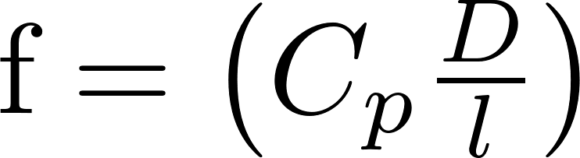
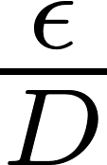
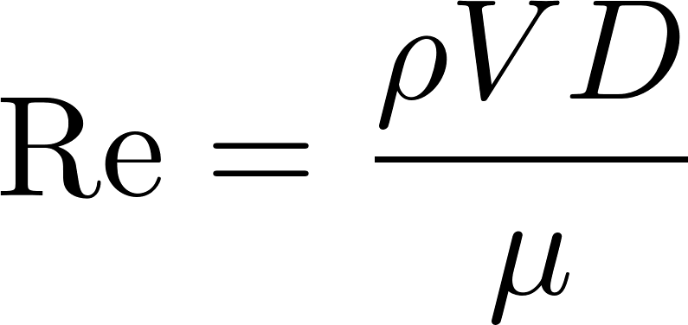
Frictional Losses in Straight Pipes: Moody Diagram
0.1
0.05
0.04
0.03
0.02
0.015
0.01
0.008
friction factor
0.006
0.004
laminar
0.002
0.001
0.0008
0.0004
0.0002
0.0001
0.01
0.00005
smooth
1E+03
1E+04
1E+05
1E+06
1E+07
1E+08
Re

Slide 20
TurbulentHeadLoss
Head loss through a long, rough pipe with turbulent flow
Decreases with increased flow
Remains constant with increased flow
Increases approximately in proportion to the flow
Increases approximately in proportion to the square of the flow
Increases in proportion to the natural log of the flow

Slide 21

Head Loss: Minor Losses
Head (or energy) loss (hL) due to: outlets, inlets, bends, elbows, valves, pipe size changes
Losses are due to expansions
Losses can be minimized by gradual expansions
Minor Losses have the form where Ke is the loss coefficient and V is some characteristic velocity (could be contracted flow velocity or expanded flow velocity or some other convenient velocity)
When V↓, some KE → thermal

Slide 22
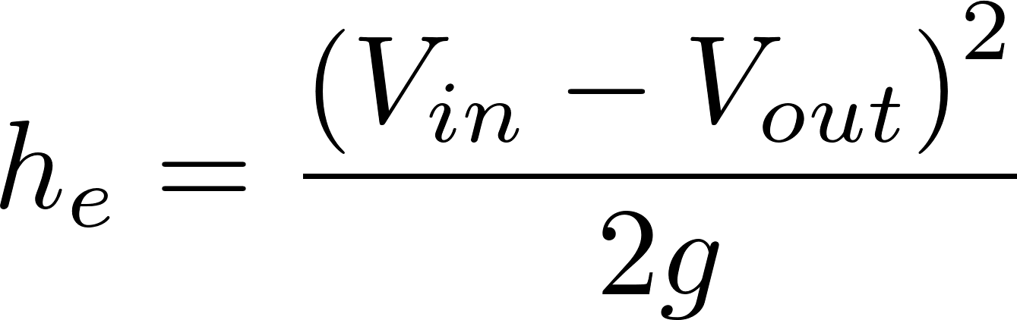
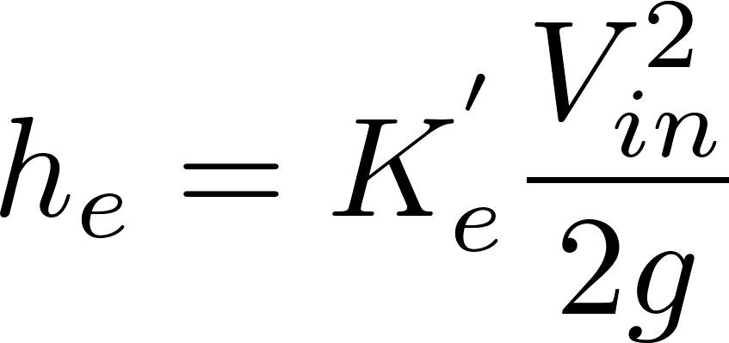
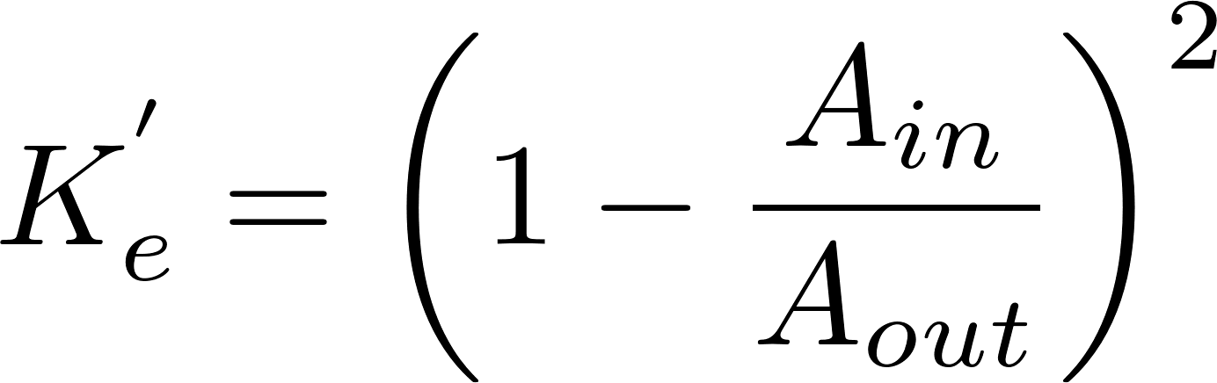
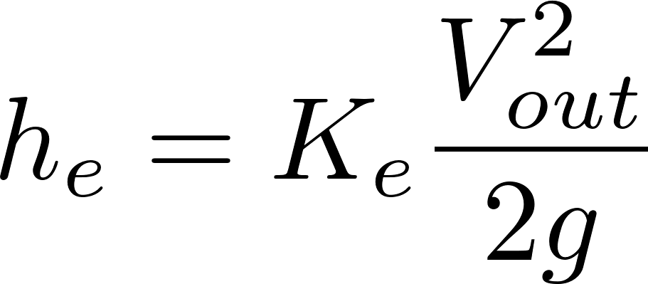
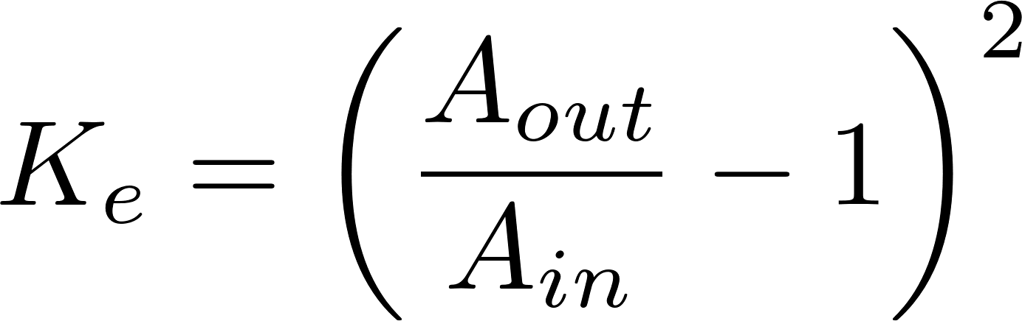
Three forms of Minor Loss equation
V_{in}
V_{out}
in
out
Most commonly used form
Notes:
Emphasize the minor loss coefficient is defined based on some relevant velocity. We can chose either V1 or V2. But the magnitude of the minor loss coefficient is determined by which velocity we use. We need to choose one and be consistent. The velocity that we choose will be a function of convenience. Minor losses are proportional to the square of the velocity. This is true whether the flow is turbulent or laminar!

Slide 23
Which points are `in` and `out` for finding the Minor Loss coefficient?
C
B
`in` should be where the flow is most compressed
A
`out` should be where the flow has fully expanded
Notes:
Draw the orifice case in detail showing expansion zone

Slide 24
Three forms of Minor Loss equation
V_{in}
V_{out}
in
out
Most commonly used form
Which form of velocity is easier to measure, V_{in} or V_{out}?
Which form of K can be greater than 1, K_{e} or K_{e}’?
What does it mean when K_{e} exceeds 1?
What is the K_{e} for a pipe discharging into a lake?
1
Notes:
Emphasize the minor loss coefficient is defined based on some relevant velocity. We can chose either V1 or V2. But the magnitude of the minor loss coefficient is determined by which velocity we use. We need to choose one and be consistent. The velocity that we choose will be a function of convenience. Minor losses are proportional to the square of the velocity. This is true whether the flow is turbulent or laminar!

Slide 25
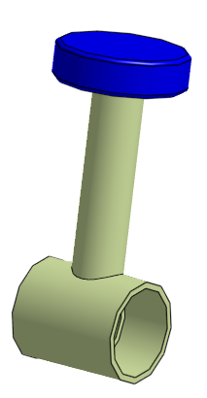
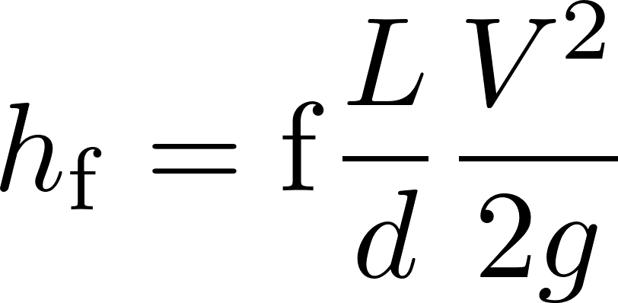
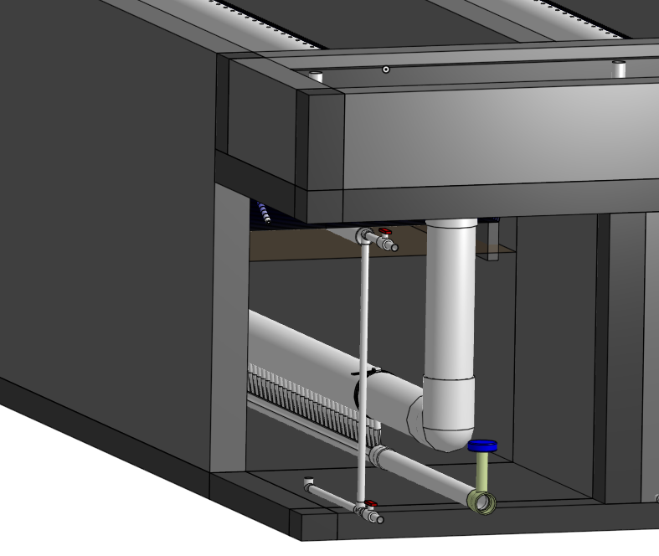
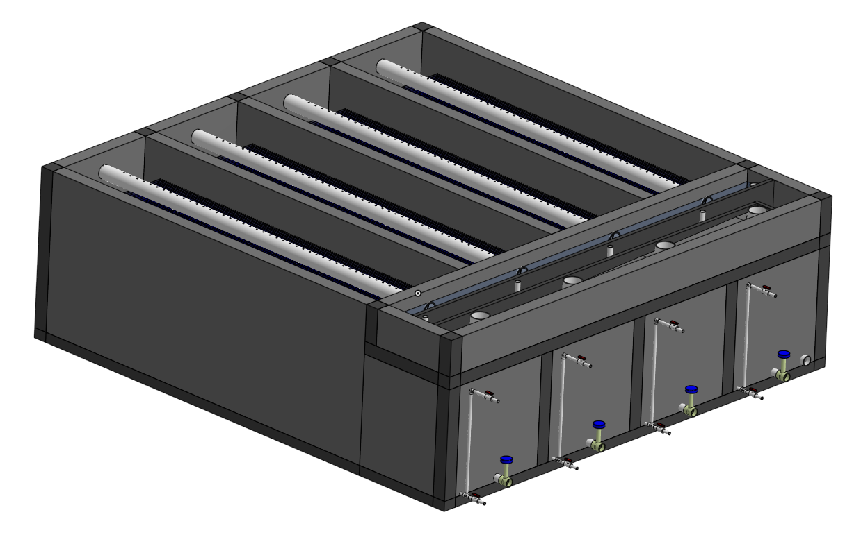
When draining a tank through a valve
major losses dominate
minor losses dominate
minor losses are equal to major losses
Notes:
How could you think about this question?
How would you PROVE what the right answer is?
Write the equations for minor and major head loss

Slide 26

Elevation difference = head loss trick
Also called the ‘head loss trick’ or ‘control volume trick
If tubing isn’t straight – another minor loss!
Small diameter tubing
Select control surfaces where you know as much as possible!
This trick is used extensively in this class,
understanding it will make it easier to understand
future course concepts!
Notes:
Why not at inlet to pipe? (would need to use Bernoulli to calculate pressure)
Show that vertical at outlet or horizontal at outlet is equivalent.
HL = fL/dV^2/2g + sumKV^2/2g

Slide 27
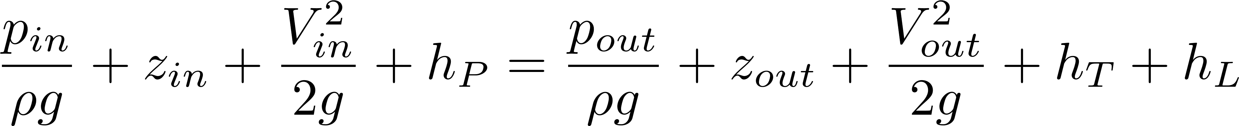
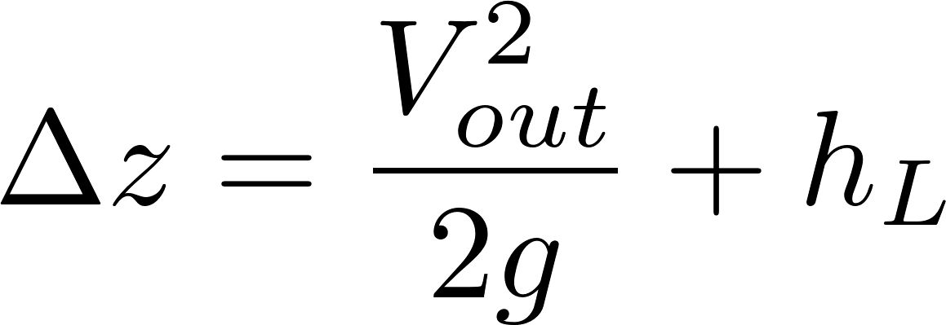
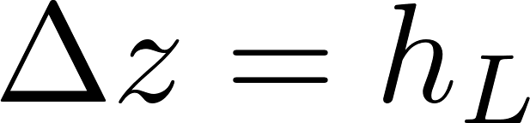
Elevation difference = head loss trick
Also called the ‘head loss trick’ or ‘control volume trick’
Small diameter tubing
Two unknowns! Q and head loss
Two equations?
The kinetic energy term gets incorporated in head loss as a minor loss with a K_{e} of 1
Click here for a more in-depth explanation

Slide 28


VerticalPipe
AguaClara/PRADAN Solar Pumped System in Jharkhand India
Water treatment facility
Minimum height for adequate pressure at highest tap
Maximum elevation change
Solar panels
Transmission Line Length
Pump control room
Minimum well water level

Slide 29
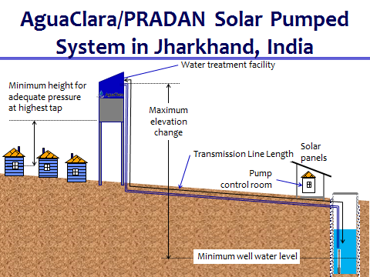
What size pipe should be used for the vertical section up the tank to maximize flow?
A 10 cm diameter pipe is used for the 500 m long transmission line
The elevated tank is 10 m tall.
2.5 cm diameter
5 cm diameter
7.5 cm diameter
10 cm diameter
What are the failure modes?
What are the constraints?

Slide 30
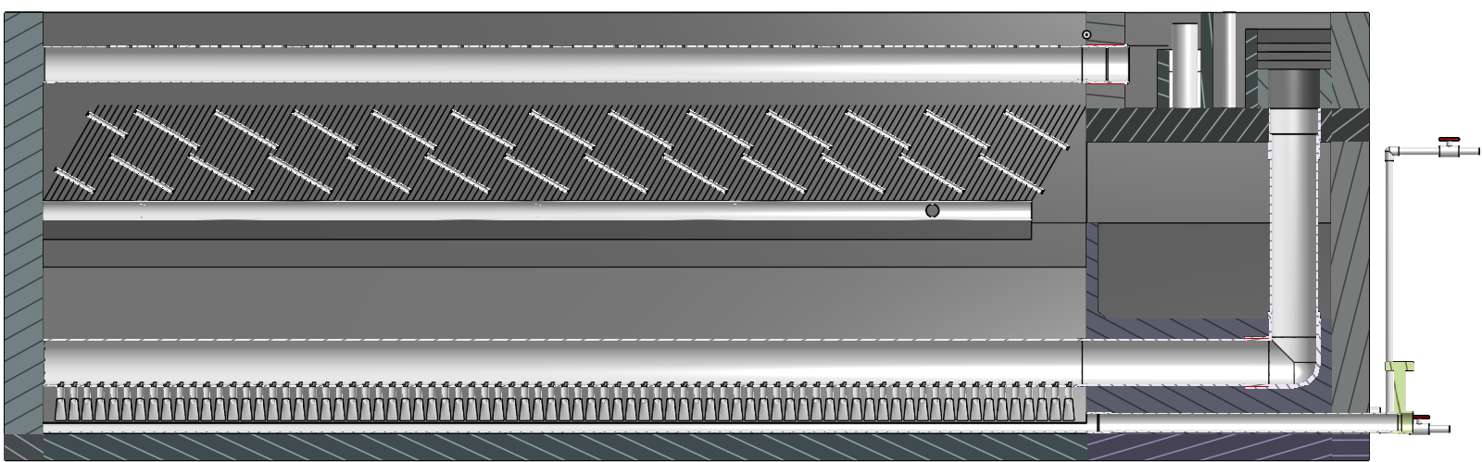
How can you make water flow up through a tank (by gravity)?

Slide 31
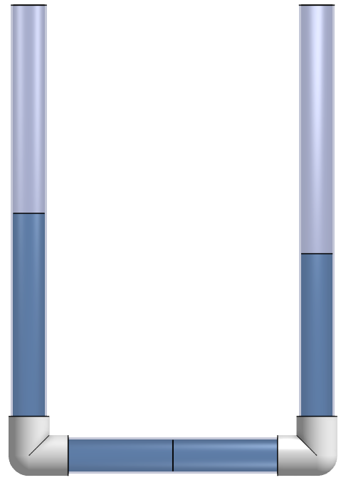
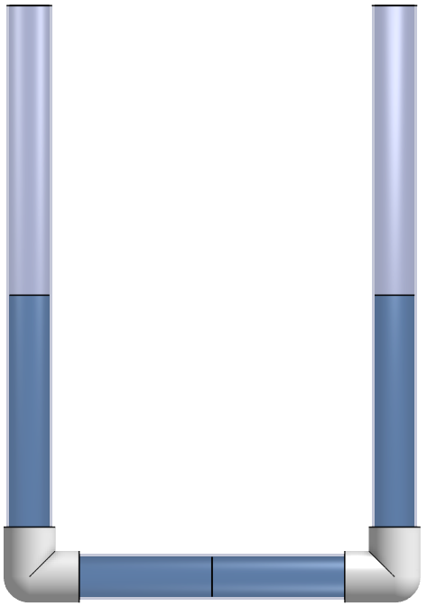
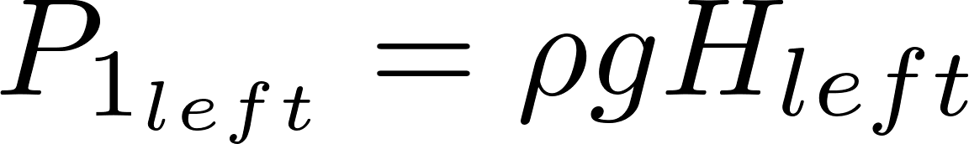
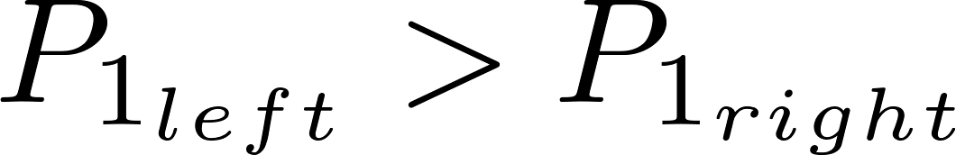
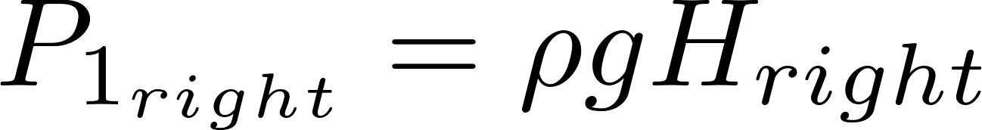
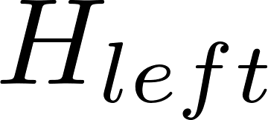
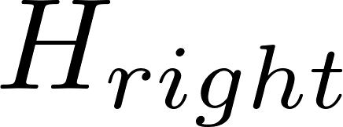
What happens next?
There can only be one pressure at a point!
This can not be a static situation!
1

Slide 32
How can you make water flow up through a tank (by gravity)?
Water flows from inlet to outlet as long as inletHW>outletHW
outlet
inlet

